Slide 1
Office Politics At Amazon Company
Student’s Name
Institution Affiliation

Slide 2
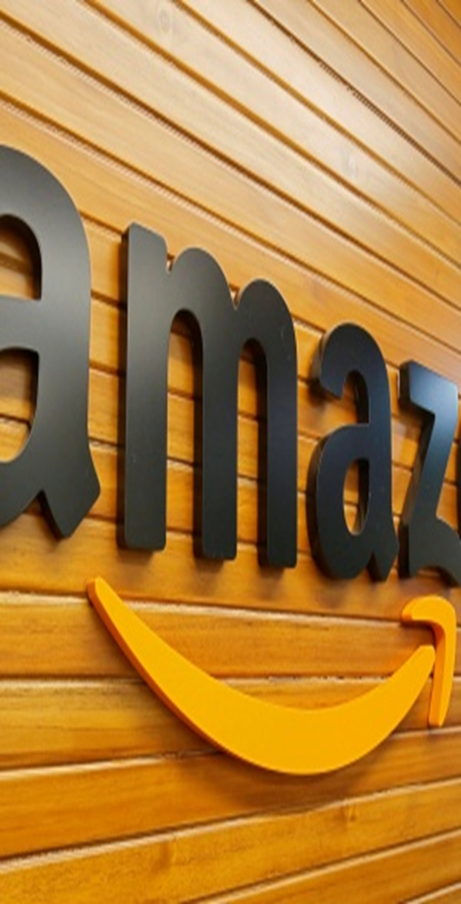
Office politics at amazon company
Common when employees wants favors or recognitions.
Occurs due to diversity that exists
Unhelpful in the long run
Healthy and cordial relationships works best (James, 2013).
Present in almost every company. Eg Amazon
Amazon Managers are always trying to control (Amazon, n.d.).
Notes:
Office politics occurs when an employee or a certain grade employee wants a better recognition than the others. Often, it appears as a competition to please the seniors at the expense of the others through tarnishing their reputation in front of their seniors. Sometimes also, diversity in the workplace might also cause office politics although this can be solved at the end.
Majority of companies in the world experience office politics. One of them is Amazon although it has hugely invested in curbing it.

Slide 3
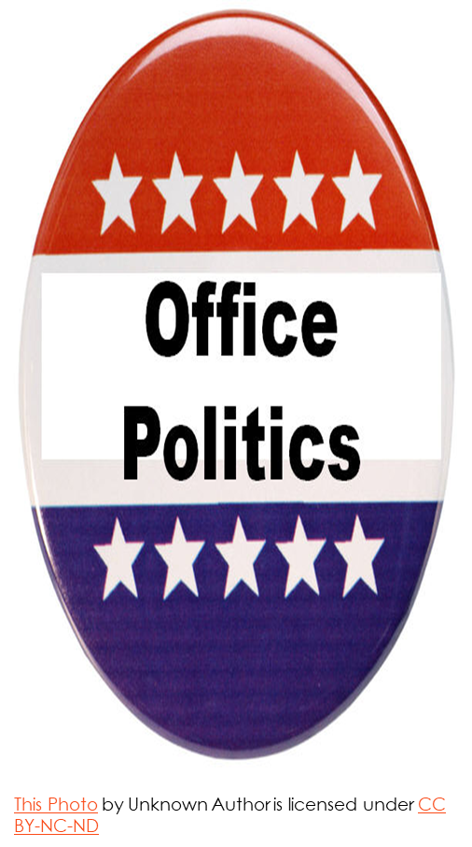
Factors Contributing To Office Politics At Amazon Company
Various factors contribute to office politics at Amazon.
Superiors- some are excessively demanding or less demanding.
Promotions and reward system
Weak organizational culture
Poor supervision at the office
Idleness at the office (Amazon, n.d.).
Notes:
There are various factors that contribute to office politics at Amazon company and any other company. Some of the factors that influence office politics are jealousy caused by diversity, the organizational culture as well as the level of supervision. Also, the time that the employees stay while resting or even idle doing the outside-the-company work has a great connection with office politics. It is either doing less or over of these issues at the Amazon that contribute to the office politics in that company.

Slide 4
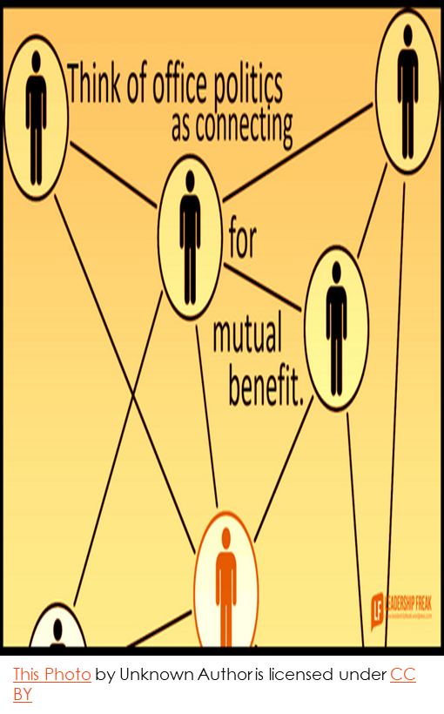
Factors Cont’
Superiors- some are in Amazon are excessively demanding hence forcing the employees to retaliate.
Promotions and reward system- this leads to dissatisfaction
Weak organizational culture- a culture that does not care a lot
Poor supervision- supervision don’t fully inspects (James, 2013).
Notes:
Under these factors, superiors contribute to amazon office politics when they are excessively demanding without needing the much-necessary. Also, a poor reward and promotional system at the amazon company is another contributing factor to office politics since the employees do not also believe in the dispute handling mechanism set up by the company. In amazon company, the culture is always designed such that there is less room for feedback from the employees, this creates a bad culture which in turn favors office politics by a large extend.

Slide 5
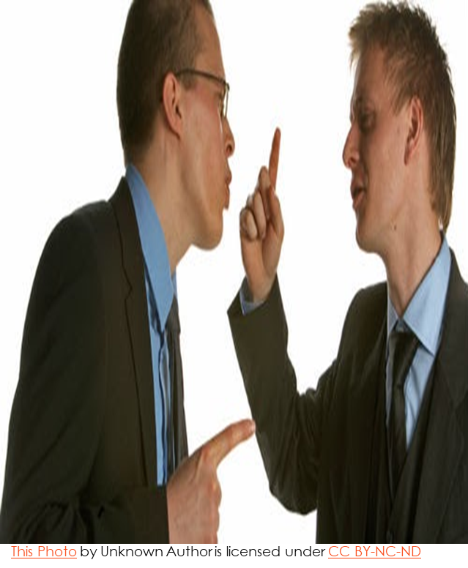
Strategies to Navigating workplace politics
Leaders should not give politics a deaf hear.
Deal with the big elephant issues effectively.
Be ready to correct your mistakes
Have a problem-solving attitude.
Note the key participants (James, 2013).
Address the minor concerns.
Notes:
A good leader can effectively navigate through the office politics to either bring to a stop or prevent their occurrence in future. One of the strategies that a good leader should apply is proper listening to his employees to identify their issues being ready to correct the mistakes. Also, the leaders should have a problem-solving attitude not just politicking like the rest. Similarly, in as much as it is essential to deal with the main concerns of the politicking, it is vital for the managers to address the minor concerns since they give birth to the big issues.

Slide 6
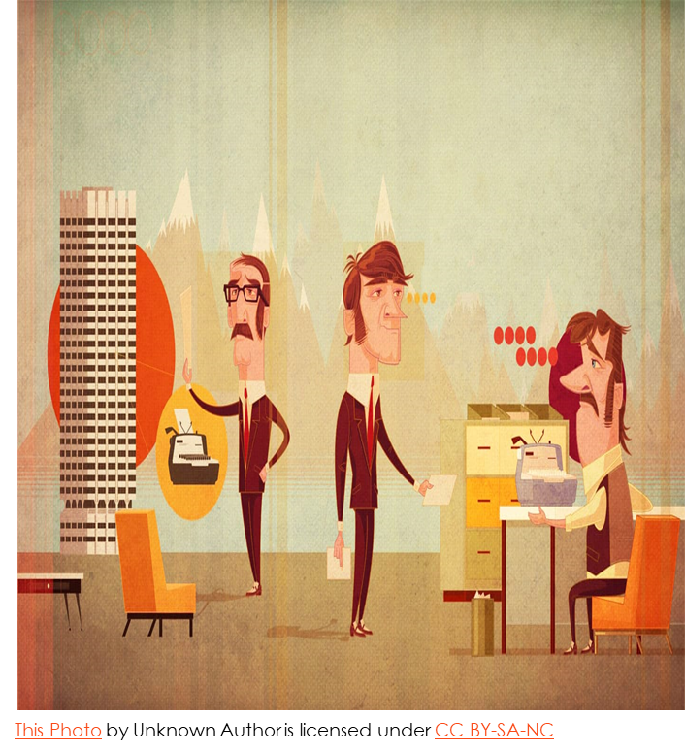
Navigating workplace politics Cont’
Establish connection with your opponents (Murray, 2018).
Plan conversations in the orders of importance.
Tactically allow yourself to be vulnerable (MSG, n.d.).
Solve problems from the most minor to the triggers (Murray, 2018).
Be rigorously honest and empathetic
Notes:
Additionally, while trying to navigate through office politics, the leaders should try to establish connection with the opponents of your tactics. The aims of this is to get their point of view and gauge its applicability in the situation. Also, the leader has to employ highest degree of honesty and being empathetic so as to be ready for every possible solution for the office politics. The leader tactically allowing himself to be vulnerable is aimed at making the leader understand others better.

Slide 7

Ineffective leaders’ strategy for office politics
They regard the participants unprofessional
They give no concentration on grievances
They carry out unplanned conversations
They assume they are ever correct (Murray, 2018). .
they have no particular order of solving problems
Rely on a single source of information.
Notes:
Ineffective leaders are an exact opposite of the effective one due to some reasons. First, they never plan on the best route of approaching the politics but instead the carry out their plans without consulting the other juniors. Also, the leaders tend not understand the fact that office politics is a common thing and therefore cannot completely make someone unprofessional. Also, these leaders do not plan their conversations and this makes them vulnerable to making mistakes.

Slide 8

Leadership Role in the Political Climate
Leader’s role is intricately related to the political climate.
the organizational politics are very well-rooted.
Leaders should strive to always give their best.
Resolutions and procedures are some of the connecting areas.
Professional relationships also forms the basis for connection.
Notes:
One fundamental fact about management and leadership in an organization is that that they are intricately connected to the politics of that politics. Consequently, leadership forms the basis of the running of the politics of the organization. Some of the ways in which leadership does this is by the strategies and procedures that it passes to every employee of the organization hence bringing the connection. Politics also develop in an organization though identification and interactions among leaders while in the organization.

Slide 9
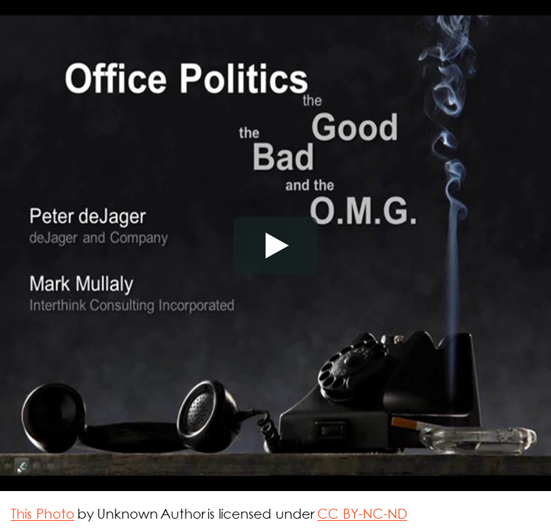
Leadership Role in the Political Climate Cont’
Identification- politics emerge when a leader has his own personal goal. manifests through struggles in the leadership cream (MSG, n.d.).
Interaction- between the leaders themselves and between juniors bring about politics (Murray, 2018).
The leaders style of exercising authority has direct impact on politics.
Notes:
Some leaders usually have identification problems as to advance their person goals at the expense of the company’s goals. This aspect brings about politics in the workplace. It is usually manifested when the leadership cream is facing some wrangles between themselves.
Interactions between leaders themselves and their juniors brings about politics. The source of these politics might be from how the leaders exercise their powers.
Leaders who are dictatorial might cause a lot of politics since some people might be championing for their removal.

Slide 10
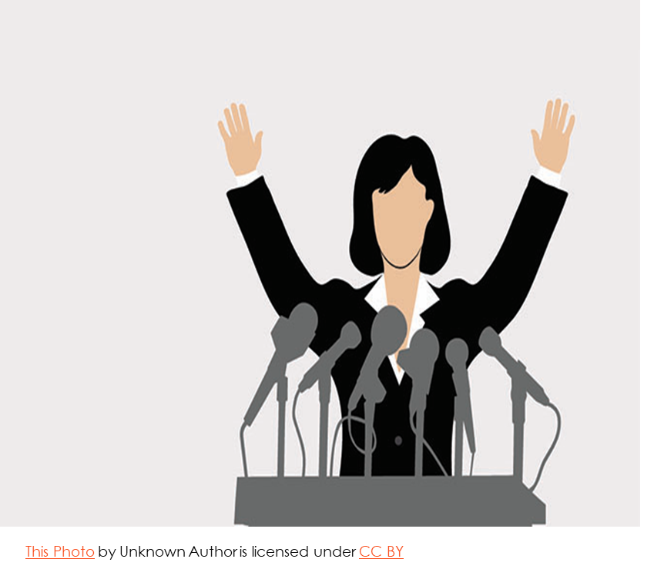
Leadership Role in the Political Climate Cont’
Strategies- agendas, motivation to employees are in the politics.
leaders strive to persuade employees to the achievement of the company’s goals.
Consideration- leaders ought to understand the political behavior of the organization (MSG, n.d.).
The leaders understands policies with direct impact.
Notes:
The strategies influence the politics of a place by how they are made and enacted. The enactment of the strategies should be such that it caters for the ideas of most people in the organization to prevent politics in their implementation
Leaders should also consider the political behaviors of an organization while implementing strategies. An organization with a strong history of history of office politics should have a wide consultation before implementation of the organization’s strategies.

Slide 11
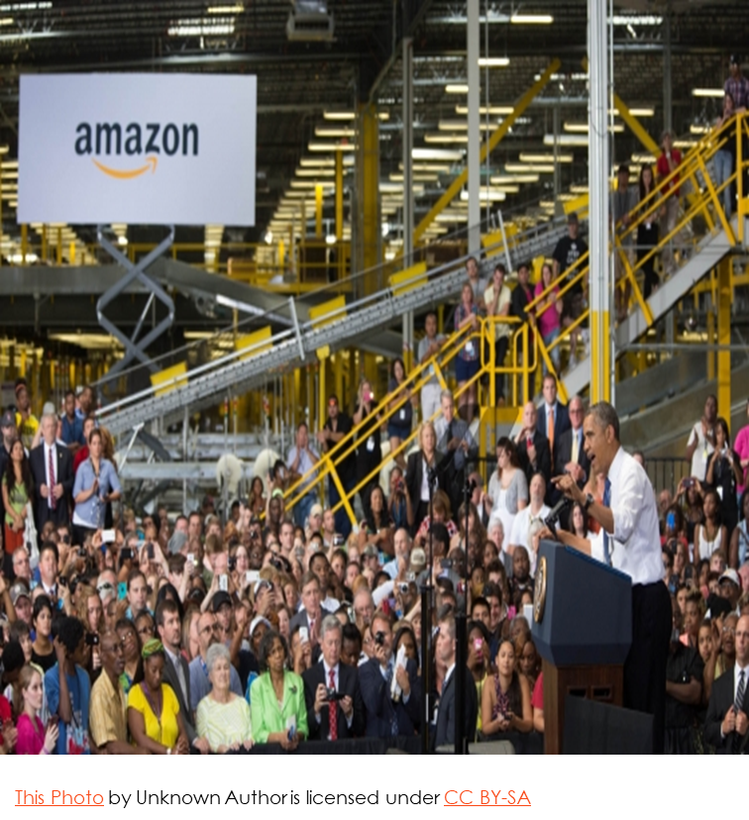
Conclusion
Office politics is very common in workplaces.
organizational culture and leadership influences the office politics.
Effective Leaders communicate well and are logical in problem solving hence able to tackle office politics.
Ineffective leaders have no particular order of tackling office politics.
leadership merges with politics through interactions and strategies
Professional relationships also forms the basis for connection.
.
Notes:
Finally, office politics is not something that is very new in the emerging management issues. Jealousy as well as diversity of opinions fuels majority of the most the organizational politics. The leadership style as well as the organizational culture are some of the factors influencing office politics.
Effective leadership create a problem-solving attitude as well proper communication coupled with consultation to tackle office politics. Ineffective leaders do not follow the right methods in tackling office politics. Also, the strategies as well as interactions in leadership are some of the areas where leadership is connected to politics.

Slide 12
References
Roderick, I. (2016). The politics of office design. Journal of Language and Politics, 15(3), 274-287.
James, O. (2013). Office Politics: How to Thrive in a World of Lying, Backstabbing and Dirty Tricks. Random House.
Amazon. (n.d.). About Amazon. Retrieved from https://www.aboutamazon.com/?utm_source=gateway&utm_medium=footer
MSG. (n.d.). Workplace Politics - Meaning and Reasons for Office Politics. Retrieved from https://www.managementstudyguide.com/workplace-politics.htm
Murray, D. (2018, February 7). 10 Effective Ways To Navigate Work Politics. Retrieved from https://www.forbes.com/sites/forbestechcouncil/2018/02/07/10-effective-ways-to-navigate-work-politics/#235c193f6ef5

